Slide 1

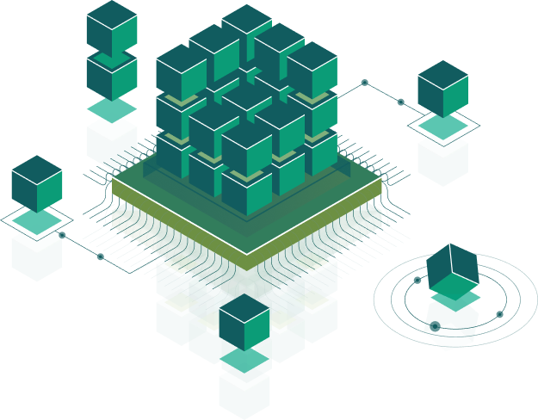
Architectural Patterns
Speaker:
Igor

Slide 2

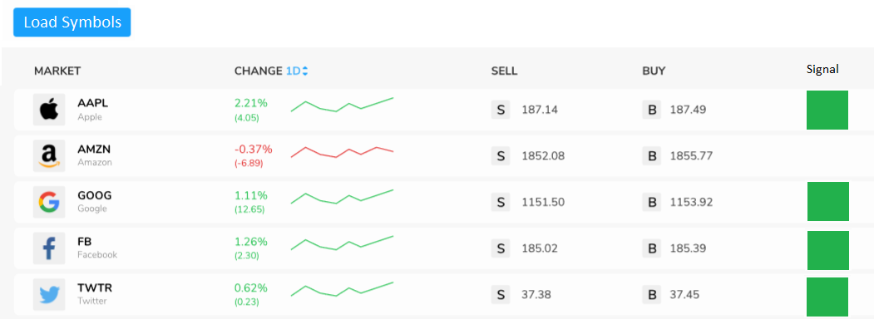

Slide 3
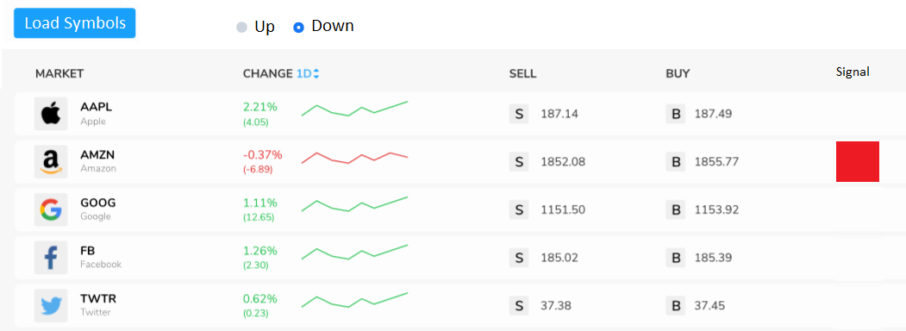

Slide 4
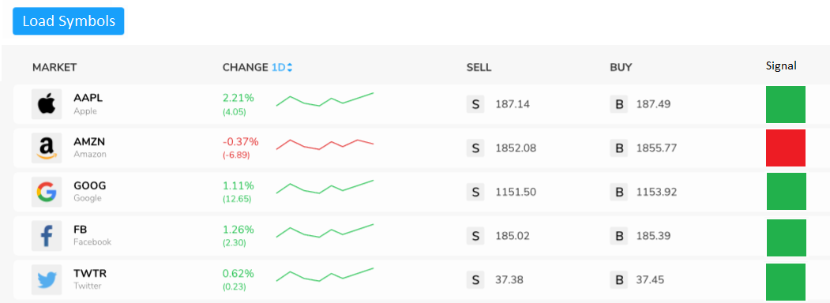

Slide 5
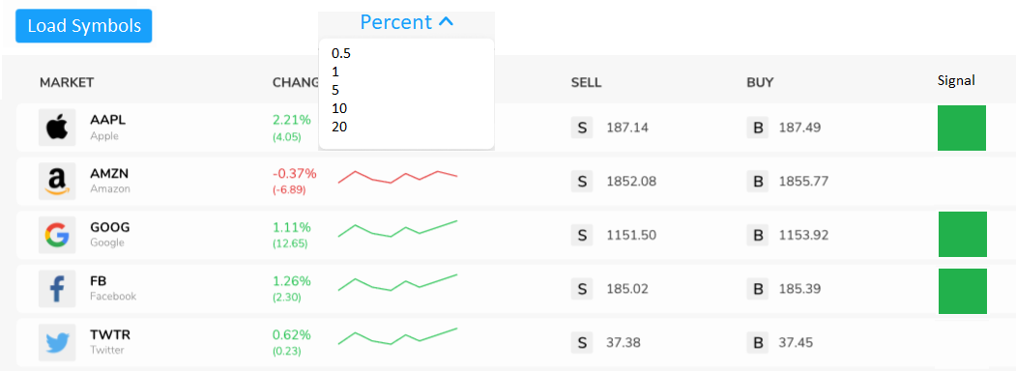

Slide 6
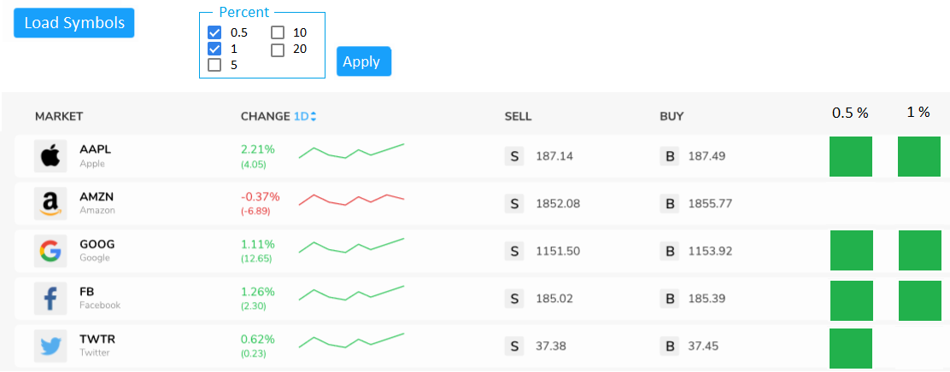

Slide 7
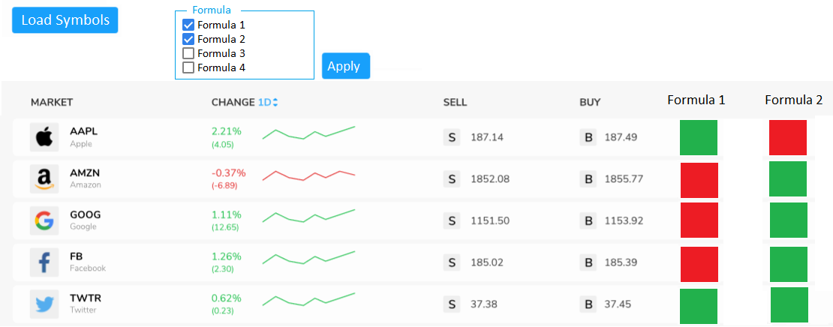

Slide 8
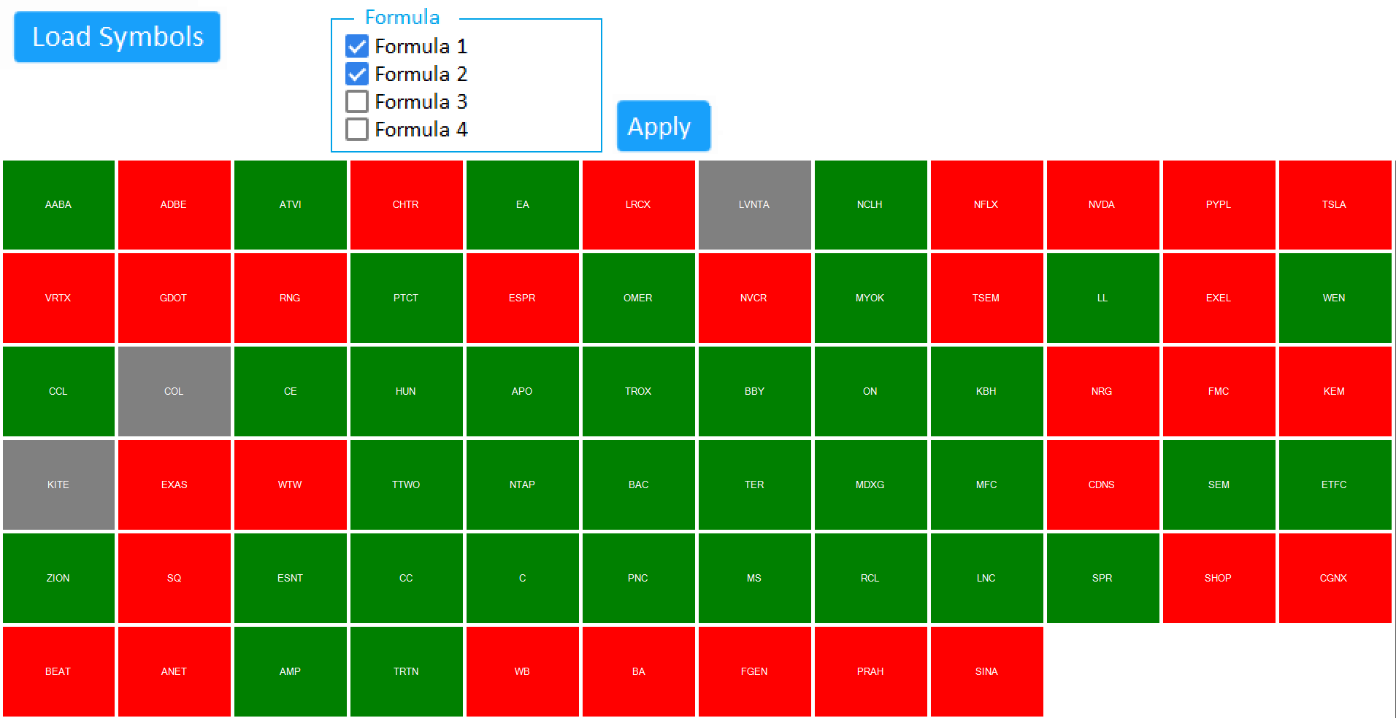

Slide 9
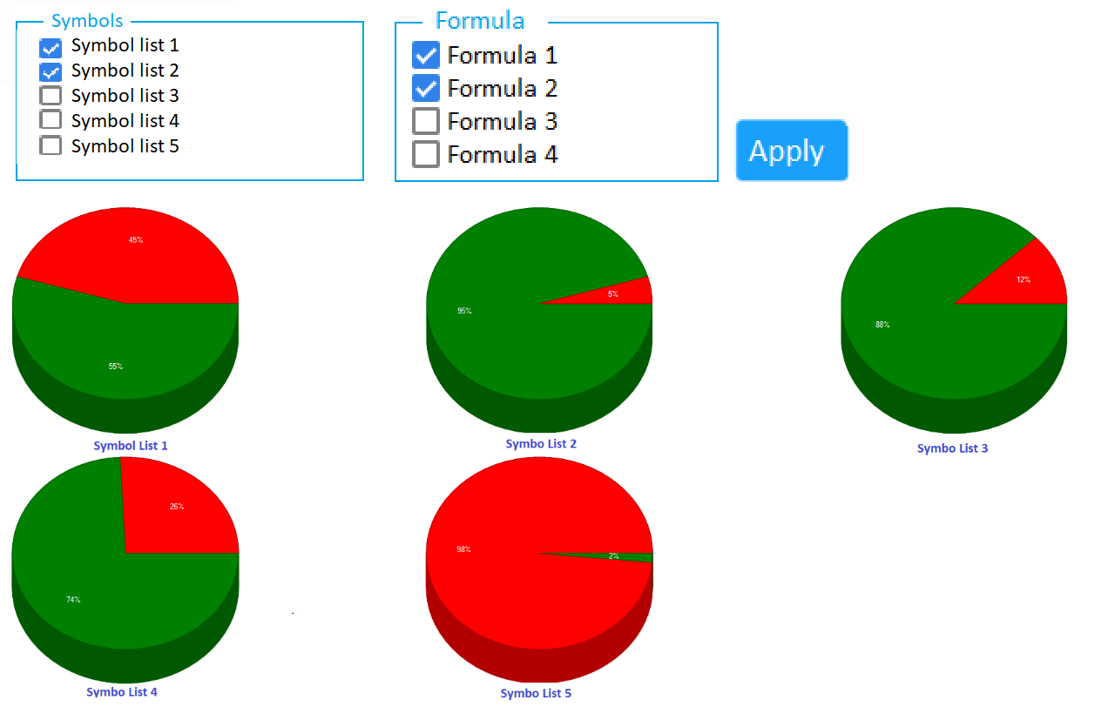

Slide 10

Separation of Concerns
All these methods do only one thing “Separation of Concerns” or “Layered Architecture” but in their own way.
All these concepts are pretty old, like idea of MVC was tossed in 1970s.
All these patterns forces a separation of concerns, it means domain model and controller logic are decoupled from user interface (view). As a result maintenance and testing of the application become simpler and easier.

Slide 11
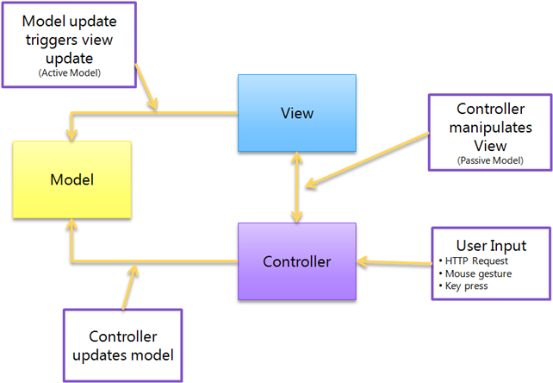
MVC - Model-View-Controller

Slide 12
Model
The model typically is the data of your application and the logic to retrieve and persist that data. Often, this can be based on a database or the results from web services. In some cases, that model maps perfectly to what you see on the screen, but in other cases it has to be adapted, aggregated or extended to be usable.
View
The View was responsible for drawing the UI on the screen. Without windows or controls, that meant drawing, boxes, buttons, input fields, etc on the screen. The View can also monitor the model and display any data in it or update itself if the data changes.
Controller
The controller is responsible for handling the User Input and then updating the Model or the View. So if the user is interacts with the application, IE: presses a button on the keyboard, moves the mouse, the controller is notified of that user gesture and decides what to do with it. Maybe it should update the view, maybe it should update the model.

Slide 13
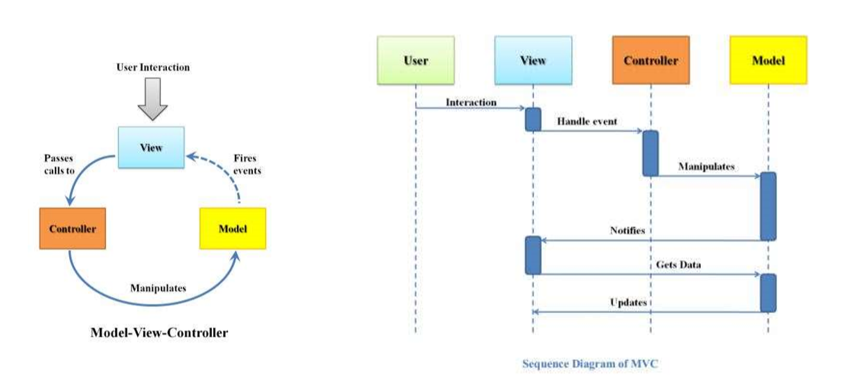
Sequence Diagram

Slide 14

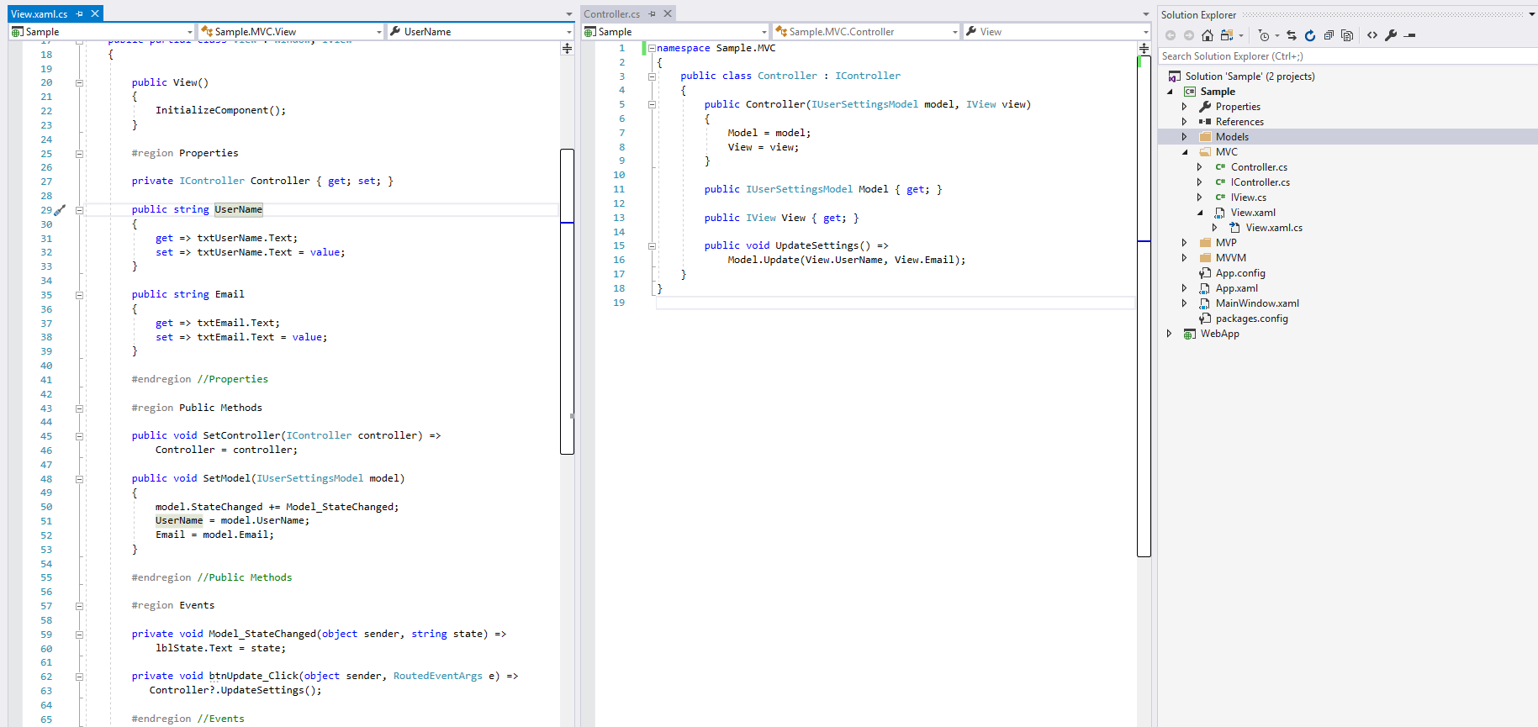
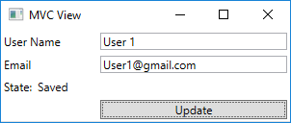

Slide 15
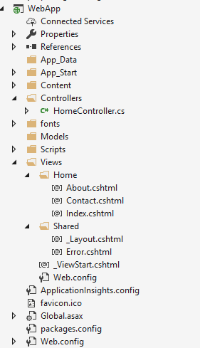
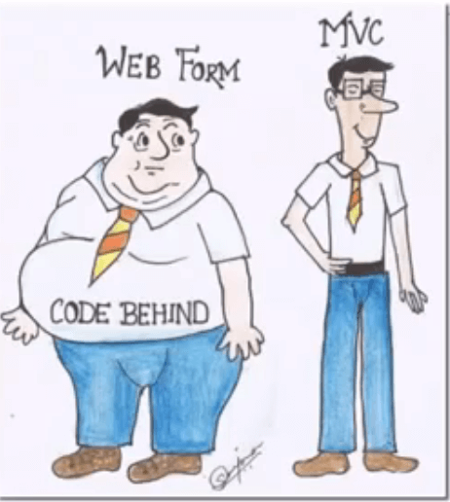

Slide 16
Advantages of MVC
Since MVC handles the multiple views using the same enterprise model it is easier to maintain, test and upgrade the multiple system.
It will be easier to add new clients just by adding their views and controllers.
Since the Model is completely decoupled from view it allows lot of flexibilities to design and implement the model considering reusability and modularity. This model also can be extended for further distributed application.
It is possible to have development process in parallel for model, view and controller.
This makes the application extensible and scalable.
It is really effective with Microsoft’s ASP.Net and Entity Framework.

Slide 17
Disadvantages of MVC
Requires high skilled experienced professionals who can identify the requirements in depth at the front before actual design.
It requires the significant amount of time to analyze and design. •
This design approach is not suitable for smaller applications.
In case of complicated user interface with states of views related to each other and
Possible workflow models, this information though not business functionality related
Has to be in the Model layer. In very large systems this may be beneficial, otherwise it is usually transferred to the control layer, somewhat breaching the pattern.

Slide 18
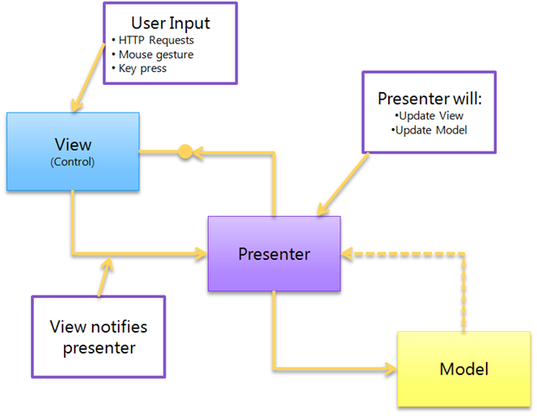
MVP - Model View Presenter

Slide 19
Model
The model typically is the data of your application and the logic to retrieve and persist that data. Often, this is a domain model that can be based on a database or the results from web services. In some cases, that domain model maps perfectly to what you see on the screen, but in other cases it has to be adapted, aggregated or extended to be usable.
View
The View is typically a user control or form that combines several (smaller grained controls) into a (part of a) user interface. The user can interact with the controls in the View, but when some logic needs to be started, the view will delegate this to the presenter.
Presenter
The presenter holds all the logic for the view and is responsible for synchronizing the model and the View. When the view notifies the presenter that the user has done something (for example, clicked a button), the presenter will then update the model and synchronize any changes between the Model and the View.

Slide 20
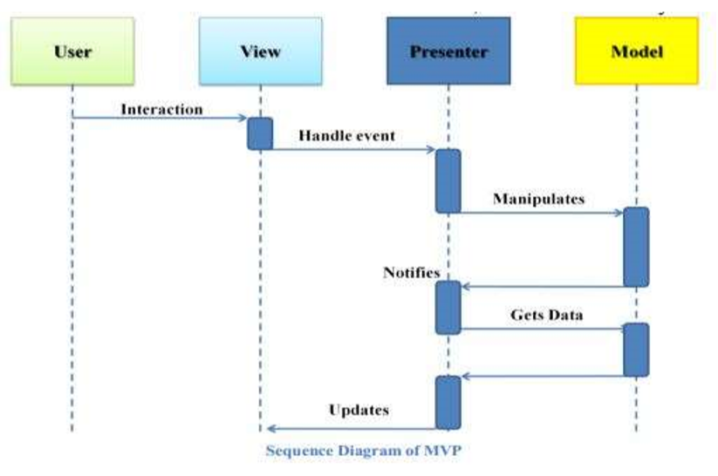
Sequence Diagram

Slide 21
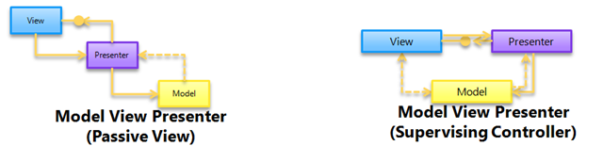
There are two variations of this pattern, Passive View and Supervising Controller.
In the passive view, the view knows nothing about the model, but instead exposes simple properties for all the information it wants to display on the screen. The presenter will read information from the Model and update the properties from the model.
In supervising controller, the View DOES know about the Model and is responsible for databinding the model to the view. This makes the interaction between the Presenter and the View a lot less chatty, but at the expense of testability of the View-Presenter interaction.

Slide 22
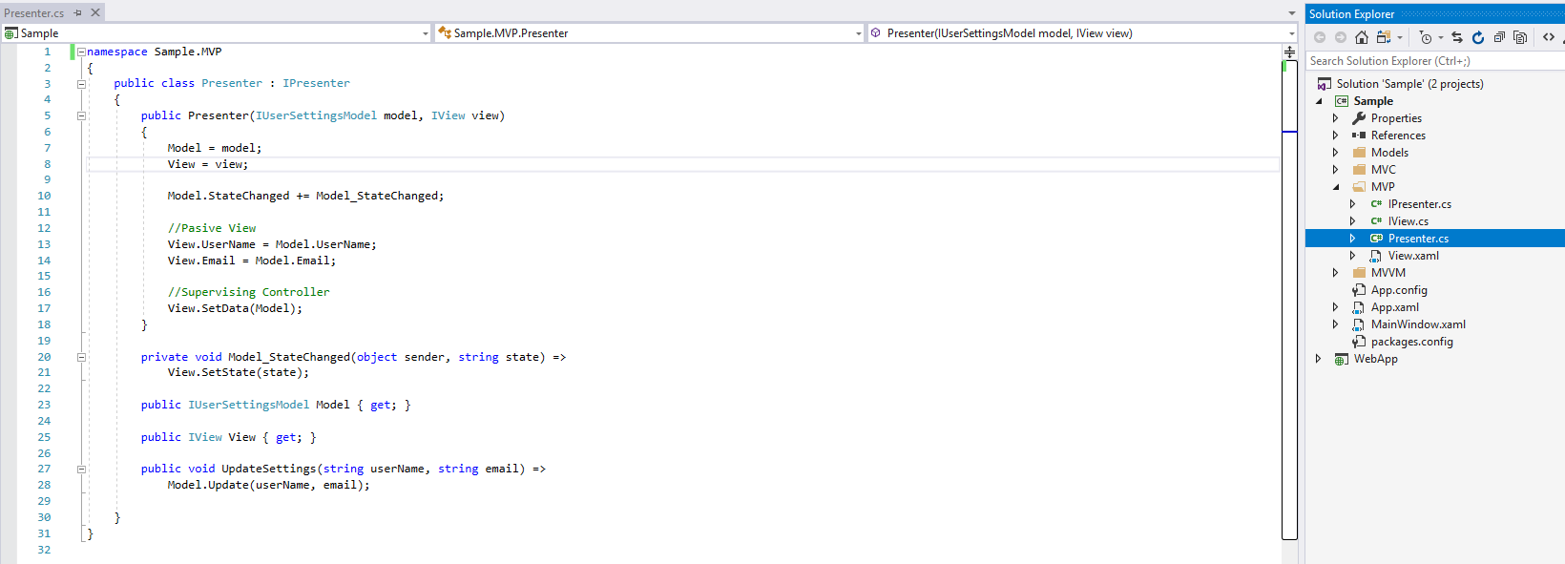

Slide 23
Advantages of MVP
As with Model-View-Controller, Model-View-Presenter has the advantage that it clarifies the structure of our user interface code and can make it easier to maintain.
Not only do we have our data taken out of the View and put into the Model, but also almost all complex screen logic will now reside in the Presenter.
We have almost no code in our View apart from screen drawing code ModelView-Presenter also makes it theoretically much easier to replace user interface components, whole screens, or even the whole user interface (Windows Forms to WPF for example).
This makes the user opinion sensitive UI part perfectly separate of other parts of the application, hence it’s features can be enhanced separately with more involvement from the customer.
In addition unit testing the user interface becomes much easier as we can test the logic by just testing the Presenter.

Slide 24
Disadvantages of MVP
Requires high skilled experienced professionals who can identify the requirements in depth at the front before actual design.
It requires the significant amount of time to analyze and design.
This design approach is not suitable for smaller applications. It overkills the small applications.
It can be hard to debug events being fired in active Model-View-Presenter.
The Passive View version of Model-View-Presenter can lead to a certain amount of boilerplate code having to be written to get the interface into the View to work.
In both MVP and MVC cases the code for supporting the proper pattern implementation can be complex, hence it is not advised to use in smaller projects.

Slide 25
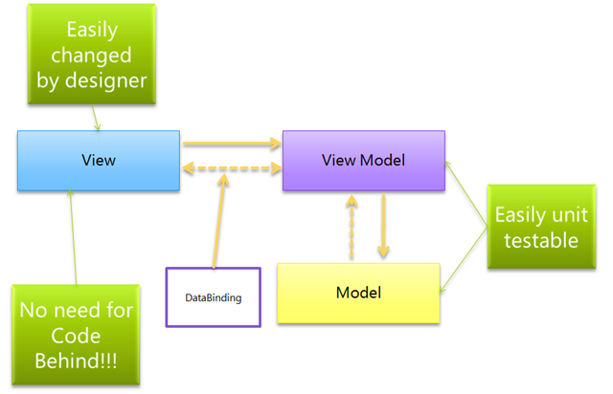
MVVM - Model View ViewModel

Slide 26
Model
The model typically is the data of your application and the logic to retrieve and persist that data. Often, this is a domain model that can be based on a database or the results from web services. In some cases, that domain model maps perfectly to what you see on the screen, but in other cases it has to be adapted, aggregated or extended to be usable.
View
The pattern we use is to set the Data Context of a view to its ViewModel. The view classes have no idea that the model classes exist, while the ViewModel and model are unaware of the view. In fact, the model is completely oblivious to the fact that the ViewModel and view exist. A View is the actual UI behind a view in the application. The elements of the UI are implemented in XAML, and as a result of this the code behind file contains minimal code, or in some cases it does not contain code at all, however it is different in Silverlight and WPF.

Slide 27
ViewModel
A ViewModel is a model for a view in the application as shown by its name. It has a collection which contain the data from the model currently needed for the view. Unlike the Presenter in MVP, a ViewModel does not need a reference to a view. The view binds to properties on a ViewModel, which, in turn, exposes data contained in model objects and other state specific to the view. The bindings between view and ViewModel are simple to construct because a ViewModel object is set as the Data Context of a view. If property values in the ViewModel change, those new values automatically propagate to the view via data binding. When the user clicks a button in the View, a command on the ViewModel executes to perform the requested action. The ViewModel, never the View, performs all modifications made to the model data.

Slide 28
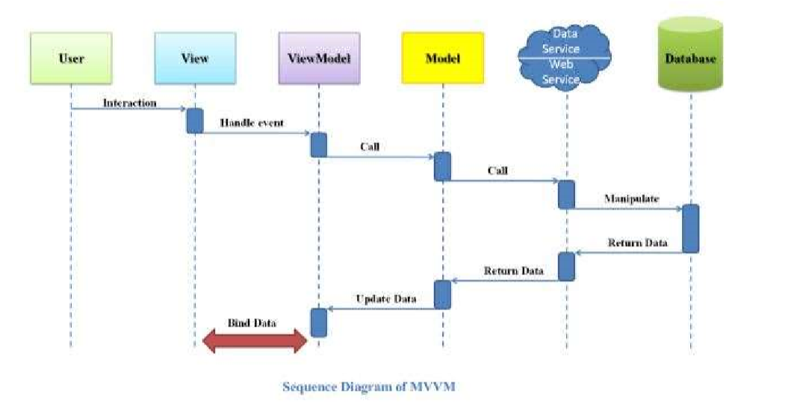
Sequence Diagram for MVVM

Slide 29
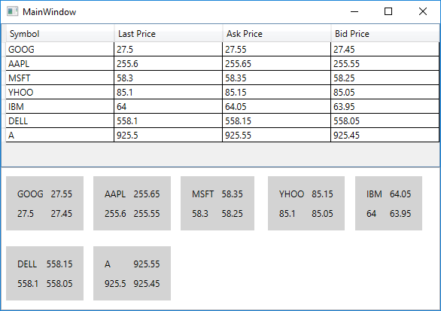

Slide 30
Advantages of MVVM
Reduces the amount of code in the View’s code behind file.
UI elements can be written in XAML
Strong Data Binding, which saves a lot of code. No need for manually refresh the view.
Disadvantages of MVVM
In bigger cases, it can be hard to design the ViewModel up front in order to get the right amount of generality.
Data-binding for all its wonders is declarative and harder to debug than nice imperative stuff where you just set breakpoints.

Slide 31
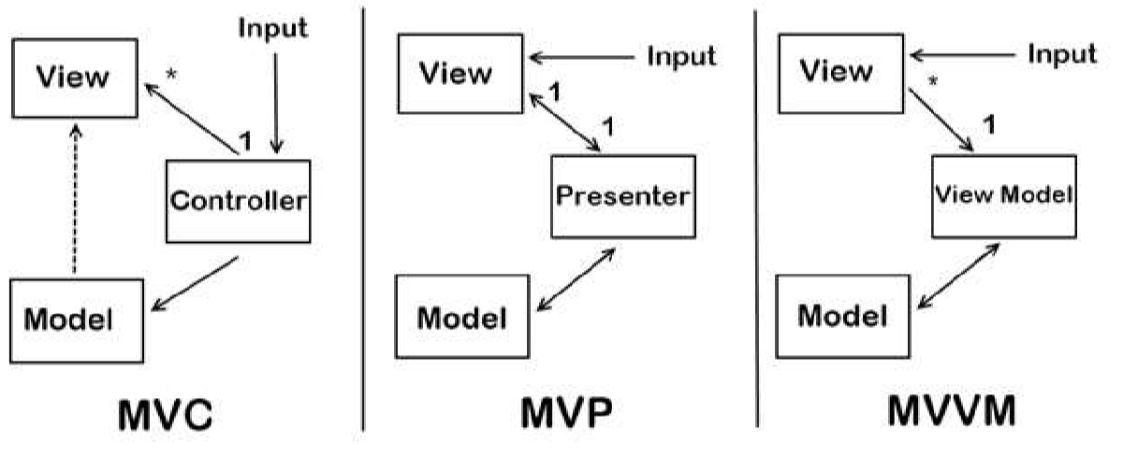
Summary

Slide 32

Thank you!

